Slide 1
Don’t Touch The White Tile
By Md. Zadidul Hasan (#11) and Mehreen Rahman (#61)

Slide 2
Submitted by:
Md. Zadidul Hasan (#11)
Mehreen Rahman (#61)

Slide 3
Our Presentation includes:
Introduction to our game
How The Game Works
Inside The Coding Part
A Look Inside The Game
Technological Components
Difficulties Faced and Lessons Learnt
Application Of OOC
Resources

Slide 4
Introduction To Our Game
This is a very popular android game. The objective of this game is to click on the black tiles only and always to avoid white tiles.

Slide 5
How The Game Works
There will be a 3*3 distribution of tiles
Will have to click on the black tile as soon as possible
If a white tile is clicked, game will be over.

Slide 6
Inside View Of The Coding Part
Classes:
There are 3 classes in the entire project
DontTouchTheWhiteTile.java:
Variables: public ArrayList<Tile> tiles;
public Renderer renderer;
public Random random;
public int score, milSecDelay;
public boolean delay;
public boolean gameOver;

Slide 7
Inside View Of The Coding Part
Methods:
-public void start()
-public void actionPerformed(ActionEvent e)
-public void render(Graphics g)
-public void mousePressed(MouseEvent e)

Slide 8
Inside View Of The Coding Part
Tile.java:
Variables: public int x, y;
public int animateY;
public boolean black;
Methods:
-public boolean pointinTile(int x, int y)

Slide 9
Inside View Of The Coding Part
Renderer.java:
Methods:
-protected void paintComponent(Graphics g)

Slide 10
Inside View Of the Coding Part
Some of the methods explained:
Start(): We are fixing the color of the tiles and we’re adding the tiles accordingly to form the frame.
Render(Graphics g): If the game is not over, then the tiles in the frame will be colored accordingly and the score will increase as well. If not, then “Game Over” will appear on the screen.

Slide 11
Inside The Coding Part
mousePressed(MouseEvent e): In this part, if the mouse is clicked, it will first initialize if the tile is black or white. According to the rule, if the tile is white, the game will be over instantly. If not, then the score will be increasing accordingly and the game will move forward.

Slide 12
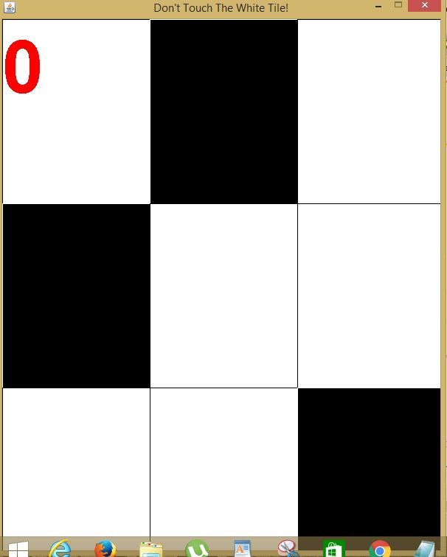
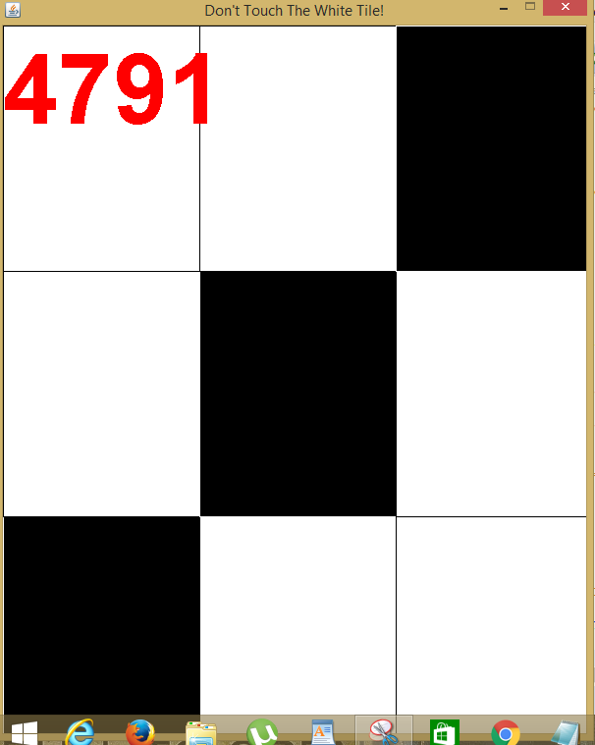
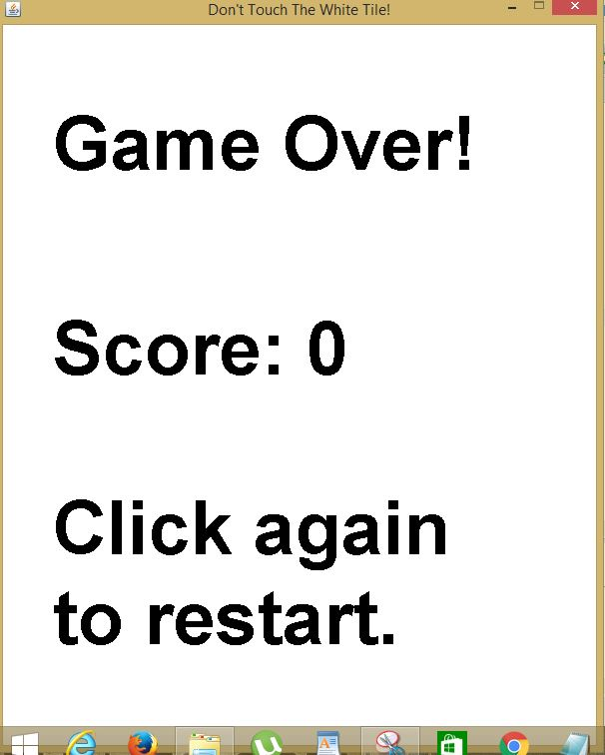
A Look Inside The Game

Slide 13
Technological Components
The IDE that has been used is Eclipse Mars.2 and the required packages are:
AWT package
UTIL package
Swing package
Text package
Net Package

Slide 14
Challenges Faced and Lessons Learnt
Difficulty in setting the speed
Difficulty in setting the score
Difficulty in setting the animation
With the help of resources, we were able to overcome these challenges.
Also this is the first time we worked in GUI. It was a good experience.

Slide 15
Implementation Of OOC
Implementation of proper classes, variables, constructors and methods
Implementation of public, protected and Boolean methods
Implementation of inheritance and exception

Slide 16
Resources:
Herbert Schildt : Java-The Complete Reference
Tutorials Point
Stackoverflow.com

Slide 17
THANK YOU!

